Slide 1
Graduate Programs in Statistics & Actuarial Science
Graduate programs:
MS in Statistics MS in Actuarial Science MS in Data Science
PhD Stat (includes Act Sci track and more)
Aug 2026

Slide 2
Director of Graduate Studies: Boxiang Wang: boxiang-wang@uiowa.edu
Department emails: statistics@uiowa.edu, actuarial-science@uiowa.edu, data-science@uiowa.edu

Slide 3
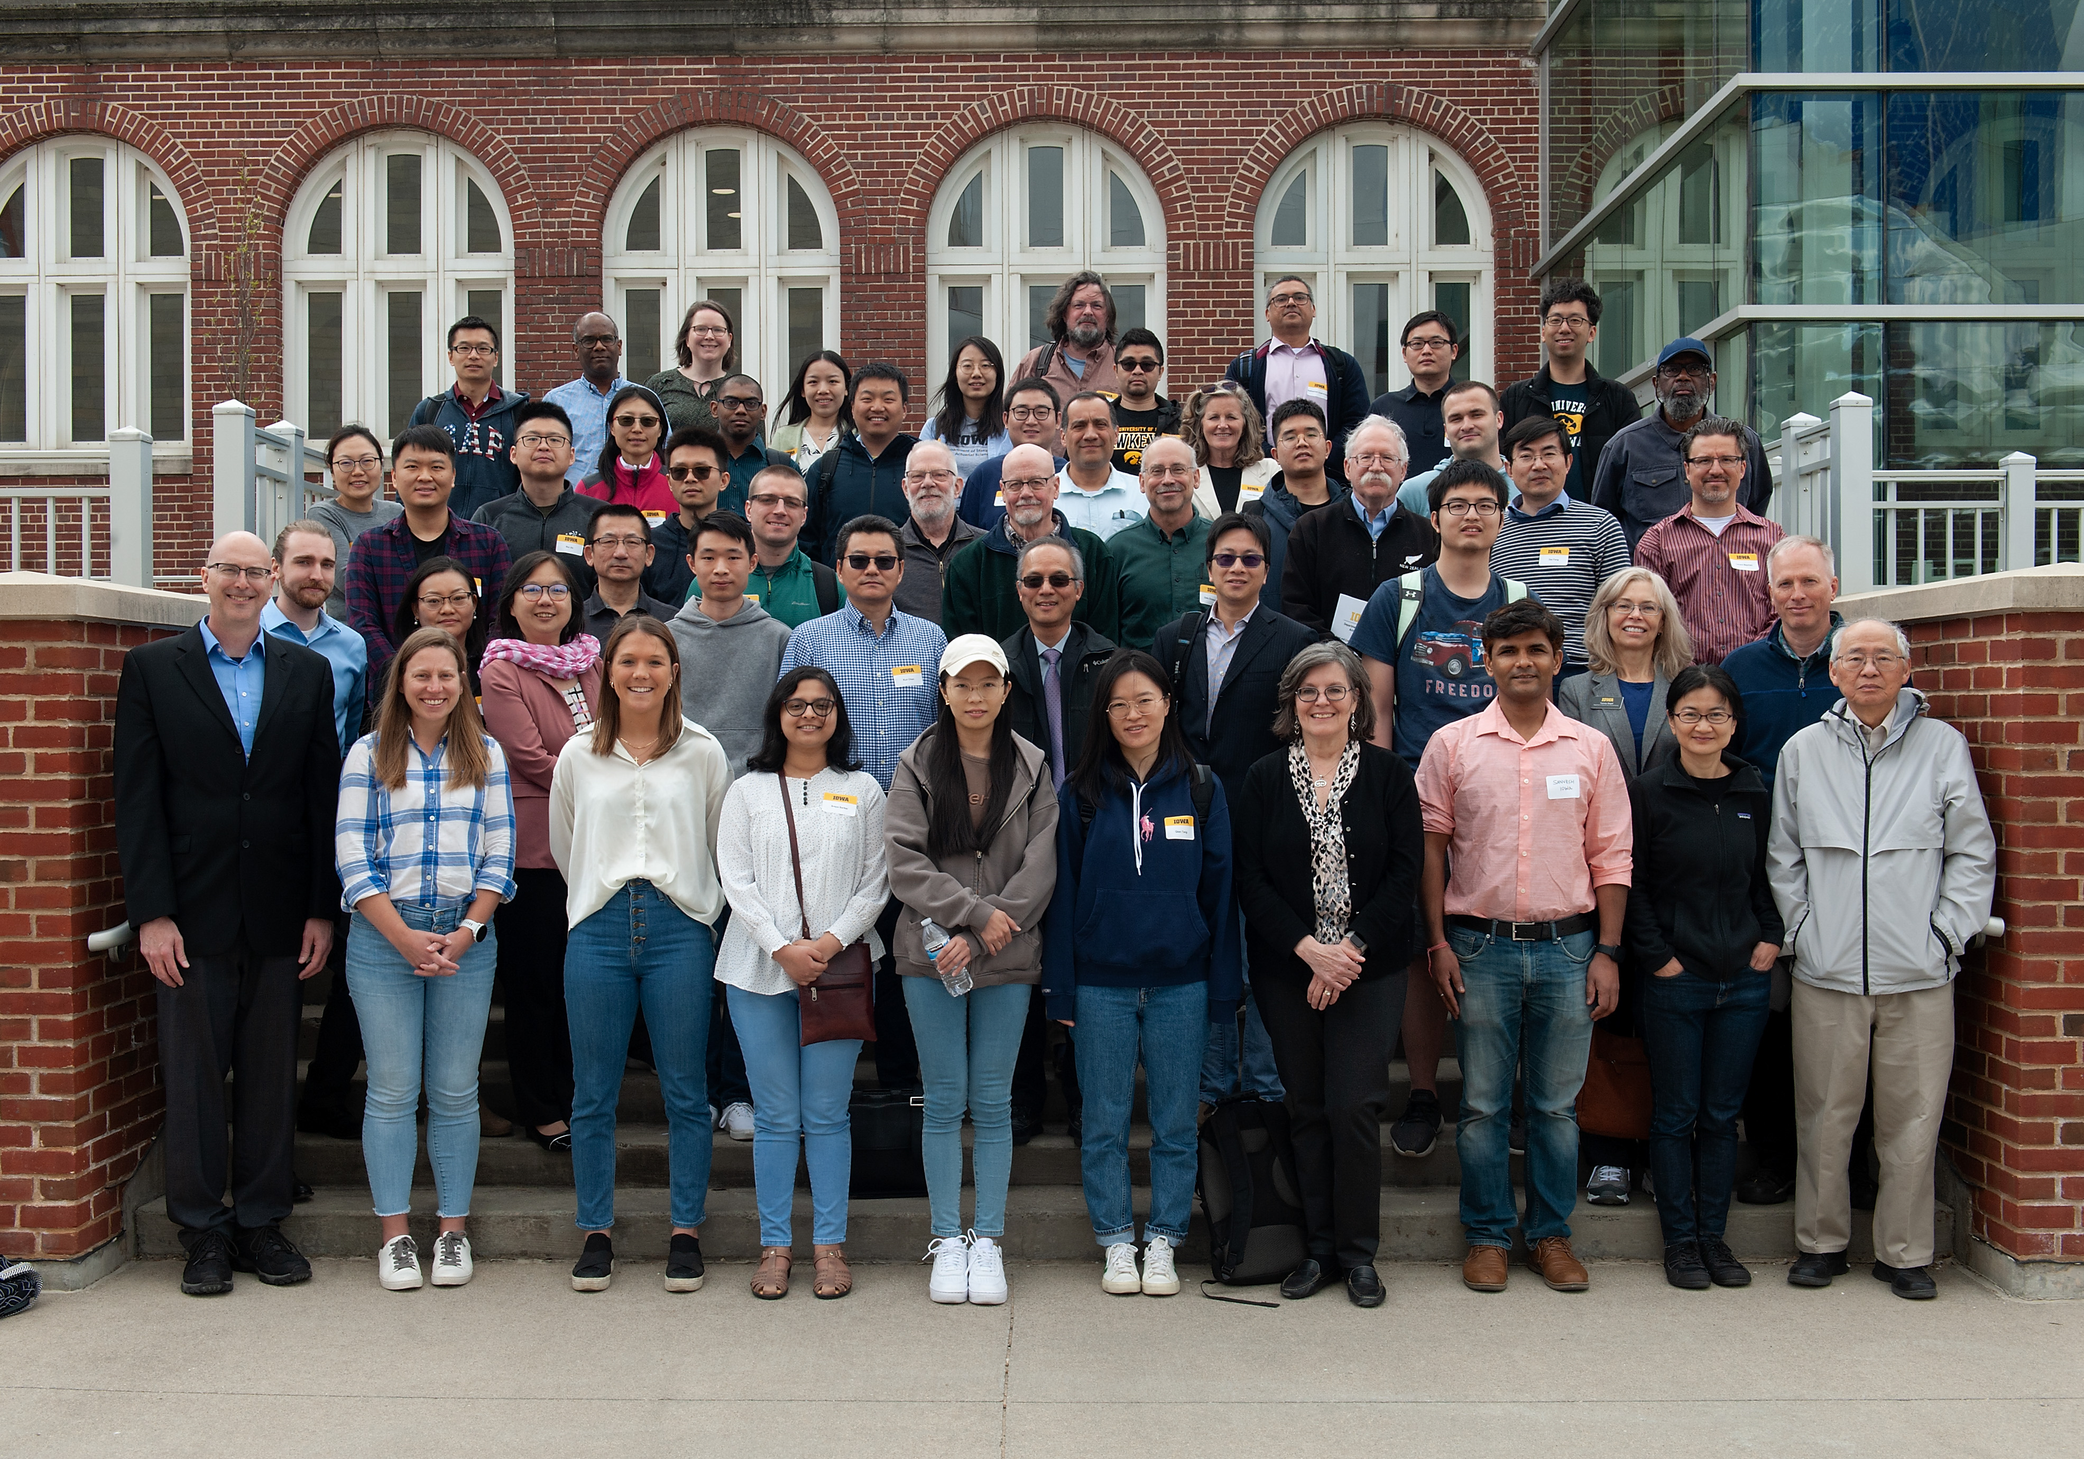
The 50th Annual Hogg-Craig Lecture
The 2-day festival was successfully organized in 2023 April.
The speaker is U Iowa Alumni,
Dr. Dan Nettleton, Chair of the Statistics Dept. at Iowa State U.

Slide 4
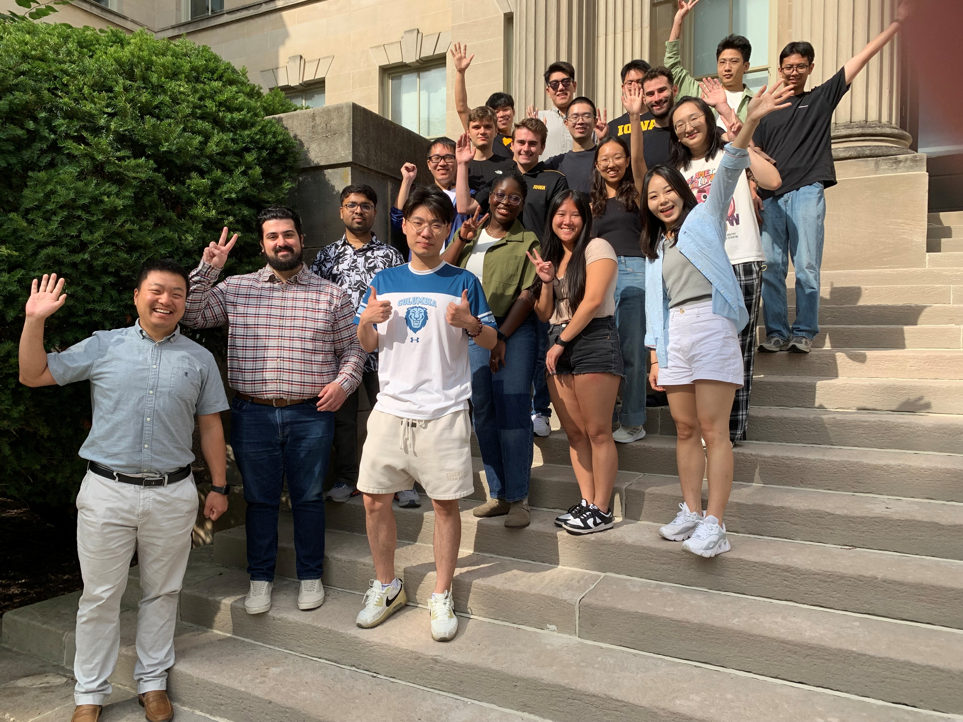
2025 Fall
Department new student orientation

Slide 5
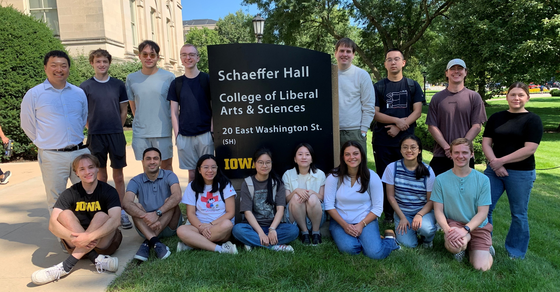
2026 Fall
Department new student orientation

Slide 6
MS in Data Science
> Solid training
> State-of-the-art curriculum
> Data science practicum

Slide 7
> Solid training
> State-of-the-art curriculum
> Data Science Practicum
MS Data Science
(30-sh in total)
Core courses (besides basic math stat and regression):
DATA:3120 Probability and Statistics
DATA:3200 Applied Linear Regression
DATA:4540 Statistical Learning
DATA:4580 Data Visualization and Data Technologies
DATA:4600 Causal Inferences for Data Science
DATA:4750 Probabilistic Statistical Learning
DATA:5890 Practicum (Internship, or Bootcamps+Datathon)
STAT:5400 Computing in Statistics
STAT:6220 Consulting and Communication with Data
STAT:7400 Computer Intensive Statistics (not offered in 27 Spring)
Key electives
DATA:4610 Data Acquisition and Management
DATA:4620 Text Data Analysis
STAT/GRAD:5091 Statistics Career Seminar
https://stat.uiowa.edu/graduate/ms-data-science#courses

Slide 8
STAT/GRAD:5091 Statistics Career Seminar
• Week 1 – Tell Your Story: Communicating Science to Non-Experts
• Week 2 – Think on Your Feet: Responding to Tough & Tricky Behavioral Scenarios
• Week 3 – Mock Interviews & Meaningful Networking: Practice Makes Progress
• Week 4 – Resumes & Cover Letters That Get You Noticed (Industry & Internships)
• Week 5 – Explore Career Pathways in Statistics, Actuarial Science, and Data Science
• Week 6 – Alumni Career Panel: Insights from the Field
• Week 7 – HR Perspectives – Hiring a Statistician/Data Analyst/Actuary
• Week 8 – Know Your Worth: Negotiating Salary & Benefits with Confidence

Slide 9
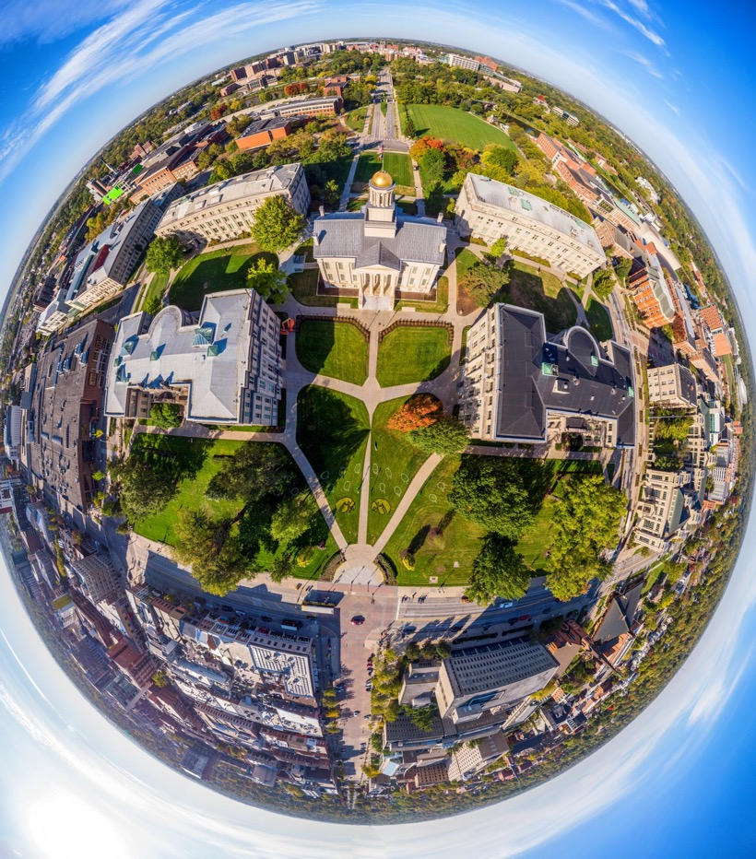

2027 Spring
DATA:4580
one elective
2028 Spring
DATA:4750
DATA:6220
MS in DS Standard Plan
2026 Fall
DATA:3120
DATA:3200
DATA:5400
(STAT:5091)
2027 Fall
DATA:4600
DATA:4890
DATA:4540
You may take 4540 in 2026 Fall, 4750 and 6220 in 2027 Spring to graduate in three semesters
DATA:4890/5890 are the same except for # of sh

Slide 10
MS in Statistics
> Solid training
> State-of-the-art curriculum
> Work closely with faculty

Slide 11
> Solid training
> State-of-the-art curriculum
> Work closely with faculty
MS Statistics
(32-sh in total)
Required core courses:
STAT:5090 Alpha Seminar
STAT:5100 STAT:5101 Statistical Inference I & II
STAT:5200 STAT:5201 Applied Statistics I & II
STAT:5400 Computing in Statistics
STAT:6220 Statistical Consulting
STAT:6300 Probability and Stochastic Processes I
At least 3 electives from:
STAT:4520 Bayesian Statistics
STAT:4540 Statistical Learning
STAT:4580 Data Visualization and Data Technologies
STAT:4750 Probabilistic Statistics Learning
STAT:5120 Mathematical Methods for Statistics
STAT:6530 Environmental and Spatial Statistics
STAT:6560 Applied Time Series Analysis
STAT:6970 Topics in Statistics
STAT:6990 Readings in Statistics (at least 2-sh)
STAT:5091 Statistics Career Seminar
STAT:7000+ One PhD-level course
In STAT:6990, students complete a project related to their application and career interests. Students will choose a faculty member as their mentor.
https://stat.uiowa.edu/graduate/ms-statistics#courses

Slide 12
2027 Spring
STAT:5101
STAT:5201
(STAT:6990)
Electives
2028 Spring
STAT:6220
Electives
MS in Stat Standard Plan
2026 Fall
STAT:5100
STAT:5200
STAT:5400
STAT:5090
2027 Fall
STAT:6300
(STAT:6990)
Electives
Core courses in MS Final
PhD students can use 7000+ courses as electives

Slide 13

Summary: Getting your
MS degree in Statistics
Required Courses
MS final exam
  Covers first year courses
  Offered in Aug., chance to make up the following Jan.
https://stat.uiowa.edu/ms-statistics

Slide 14
PhD in Statistics

Slide 15
Coursework concentrations
Data Science
Biostatistics
Probability/Mathematical Statistics
Actuarial Science
If a PhD student in statistics registers for 6 semester hours or more
(not including STAT:6990 Readings in Statistics and STAT:7990 Reading Research)
in a semester, then at least 2 semester hours of these need to be from course(s)
offered by the statistics department.

Slide 16
PhD qualifying procedure
Statistics — The faculty evaluates the student's body of work and assesses the student's potential for research.
  the MS final exam in statistics
  a project with a faculty mentor (STAT:6990)
  course work.
Actuarial Science — see webpage for details.

Slide 17
Completing the PhD program
(~5 years)
No Written PhD comprehensive exam, start research projects early
Prospectus (serves as the PhD comprehensive exam)
  written and oral report, literature review, proposed work, and preliminary results
  within 12 or 18 months of qualification to the PhD program
Writing and defending a dissertation
  within 24 months of passing the prospectus

Slide 18
PhD timeline
Year 1. ~6 courses, including 5 needed for MS final exam
  Pass the MS final exam
Year 2. ~6 courses including 1+ at PhD level
  STAT:6990 project with mentor (often becomes dissertation advisor)
Year 3. Identify dissertation advisor, PhD committee and topic. Prospectus.
Year 4~5. Complete all course requirements
  Complete and defend the dissertation

